Slide 1
Plea for consideration of Bars and Entertainment places
Presentation made by LEBRA to the OPM on 22nd July 2020

Slide 2
STRUCTURE OF PRESENTATION
Introduction
What is LEBRA?
Bar / entertainment business represents livelihoods
Challenges faced
Plea
Conclusion

Slide 3
INTRODUCTION
Following outbreak of Covid-19 pandemic, GOU put in place measures aimed at containing the spread of the disease
Bars, clubs and entertainment businesses have suffered the most having been the first ones to be closed.
LEBRA on behalf of its members is appealing to you for some relief.

Slide 4
What is LEBRA?
Legit Bar, Entertainment and Restaurant Owner’s Association Uganda Ltd (LEBRA) is an association that brings together and represents 60,000 registered bars/night clubs in Uganda with the aim of;
Contributing towards an orderly development of the entertainment industry.
Having a collective voice.
Self regulate, among others.

Slide 5
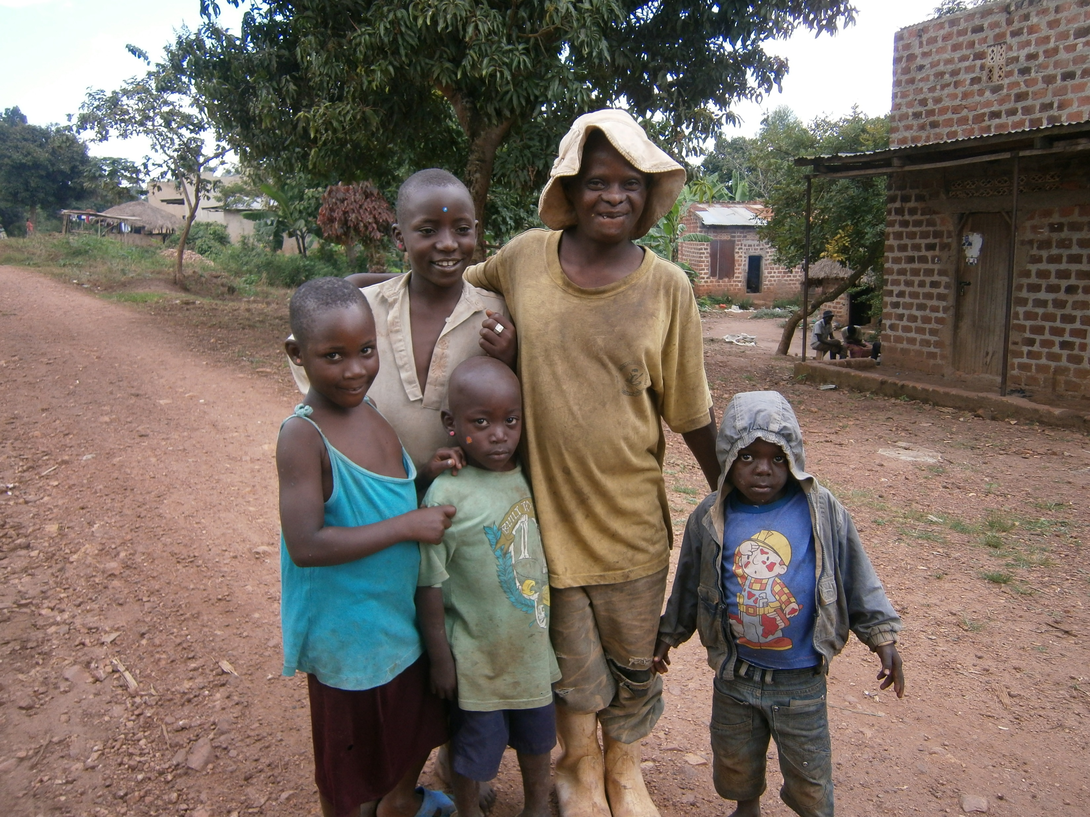
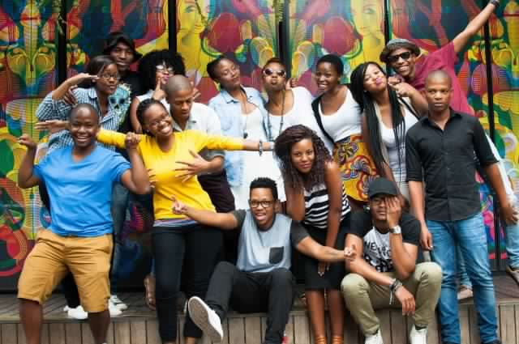
Beneficiaries (thus livelihoods)
The sector DIRECTLY employs service of over 2,000,000 people who include waitresses/waiters, barmen, cashiers, chefs, cleaners, guards, parking guides, managers, bouncers, Dj’s, marketeers, influencers, entertainers, barristers and maintenance teams.
The sector also employs INDIRECTLY over 2,500,000 people mainly suppliers and service providers from various sectors of the economy like, transport (special hire, boda boda and taxi), Security (guards), Food (fresh produce, poultry, livestock) and Real estate (mainly to landlords)
The sector is the backbone to some major businesses like;
manufacturers such as breweries, soft drinks, spirits and wine producers
Importers, traders like distributors, utilities
Gov’t is a major beneficiary as the sector is among the top ten tax payers in the country. This is besides 400bn taxes contributed by the 2 breweries we support.

Slide 6
IMPACT OF BAR CLOSURE ON ALCOHOL INDUSTRY AND ECONOMY
Total Alcohol Industry Summary
No of Businesses – 80,000
No of Employees – 200,000
No of Livelihoods – 630,000
Revenue Loss – 1.4 trillion (Annualized)
Alcohol Manufacturers
Grain Farmers
Contracted Distributors
Employees – 4,000 p’ple
Dependant livelihoods – 14,000 p’ple
Pre COVID revenue – UGX 900 bllion
Revenue Loss – UGX 430 bllion
No. of farmers – 17,000 p’ple
Dependant livelihoods – 60,000 p’ple
Pre COVID revenue – UGX 51 billion
Revenue Loss – UGX 24 billion
No. of Distributors – 120 company
Employees – 1,320 p’ple
Dependant livelihoods – 5,000 p’ple
Pre COVID revenue – UGX 1.4 trilion
Revenue Loss – UGX 600 billion
Stockists
Bars and Nightclubs
Revenue Authorities
No. of Stockists – 1,800 p’ple
Employees – 5,000 p’ple
Dependant livelihoods – 18,000 p’ple
Pre COVID revenue – ugx 1.5 trillion
Revenue Loss – ugx 650 billion
No of Bars – 60,000
Employees – 180,000
Dependant livelihoods – 540,000
Pre COVID revenue – UGX 2.5 trillion
Revenue Loss – UGX1.1 trillion
Pre COVID revenue – UGX 400 billion
Revenue Loss – UGX 250 billion
Source – UBL Internal Research
This Photo by Unknown Author is licensed under CC BY

Slide 7
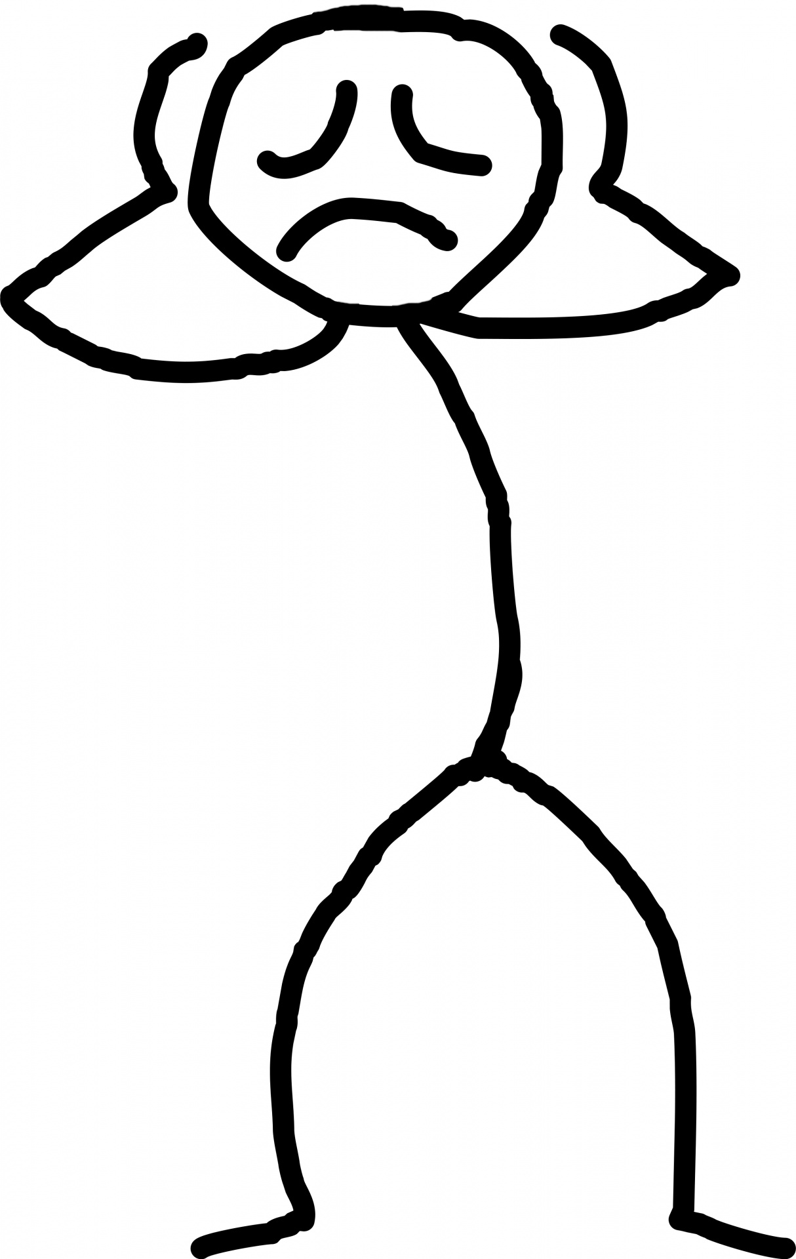
Challenges
Unemployed multitudes
Failure to pay rent and accumulation of arrears
Failure to repay loans and accumulation of interest
Failure to pay for services such as security, water, electricity and cleaning leading to discontinuation
High risk of business collapse and loss of all investments
Loss of livelihoods for bar owners, employees and landlords
Ripple effect on other businesses supported by the sector and the economy both national and local.

Slide 8
Allow bars to open and operate under strict SOP guide lines.
Washing of hands / sanitize before access.
Operate at half capacity to ensure social distancing.
Observance of at least 2 meters distance between tables.
Sanitizing of surfaces, tables and chairs before and after customers sit.
Temperature of all staff and customers checked on arrival
All staff and customers wear masks at all times
Emphasize utilization of outdoor sitting
No usage of air-conditioning
Maintain a register of patrons/customers
Submit to inspection by authorities for compliance
Support the authorities in enforcing compliance to guidelines

Slide 9
PLEA CONTINUED
2. Benefit from the government’s stimulus package through:-
Soft loans to capitalize
Help clear rent and utility arrears
Prevail over banks to allow for longer loan repayment periods with no penalties or accrual of additional interest
Prevail over landlords to allow more time for clearing rent arrears with no penalties

Slide 10
BAR SOP GUIDELINES
Bars and entertainment places are also looked at as areas where people congregate like churches and places of worship.
Gov't to dictate what Category of bars can open. Spacious bars can adhere to SOP guidelines better than "kafunda" bars
Operational hour to be maintained within the set curfew time.
Bars to have enough internal security to enforce SOP when people get drunk.
No loud music shall be allowed.
LEBRA to work with KCCA and police to check and monitor then reprimand faulting bars.
Bar owners to sign a commitment, undertaking with LEBRA, KCCA and Police to follow the SOP guidelines or else be closed.
Bars to register all patrons at entry for easy tracing there after in case of infection.
Bar shall adhere to SOP guidelines like face masks, sanitize all surfaces at all times, ensure all patrons sanitize hands and measure temperature before entry to the bar.
Control crowding by regulating entry is bar is full.
Encourage cashless transactions
All bar staff especially service staff should ware surgical gloves at all times.

Slide 11
CONCLUSION
Bar/entertainment places are run by responsible investors
Livelihoods of a wide spectrum of people in the bar/entertainment industry have been destroyed due to the lockdown and government can not continue to keep a blind eye
We recommend re-opening to allow responsible operation of businesses under strict guidelines
In addition, support to help the sector recover so as to play its rightful role in the development of Uganda is recommended
With government permission, LEBRA will spearhead the monitoring of errant bars that are not following recommended SOPs

